Slide 1

A/B Testing for increasing subscribers
E-news Express: Business Statistics
Joseph Anyanwu

Slide 2

Contents / Agenda
Executive Summary
Business Problem Overview and Solution Approach
EDA Results
Hypotheses Tested and Results
Appendix

Slide 3
Executive Summary
Users spending more time on the new page indicates that the outline & recommended content of the new page are more likely to keep customers engaged long enough to decide to subscribe.
The conversion rate for the new page is greater than the conversion rate of the old page, indicating that the new page is more likely to gather new subscribers than the existing page.
The conversion status is independent of the preferred language
The time spent on the new page does not differ with content in different languages, indicating that irrespective of the language, the outline & recommended content of the new page are engaging.
It is recommended that the news company use the new landing page to gather more subscribers, as the tests conducted support the business logic to design a page that people spend time in, and conversion will follow.

Slide 4
Business Problem Overview and Solution Approach
E-news Express is an online news portal that aims to expand its business by acquiring new subscribers based on its analysis of user actions to understand user interests and determine how to drive better engagement
The executives at E-news Express think that there has been a decline in new monthly subscribers compared to the past year because the current webpage is not designed well enough in terms of the outline & recommended content to keep customers engaged long enough to decide to subscribe
The design team of the company has researched and created a new landing page that has a new outline & more relevant content shown compared to the old page. The Data Science team experimented by displaying the old and the new landing pages to two sets of users and recording their activity. They want to test the effectiveness of the new landing page based on the data collected from the experiment.
The task is to explore the data and perform a statistical analysis (at 5% significance) to determine the effectiveness of the new landing page in gathering new subscribers for the news portal by testing certain hypotheses.

Slide 5
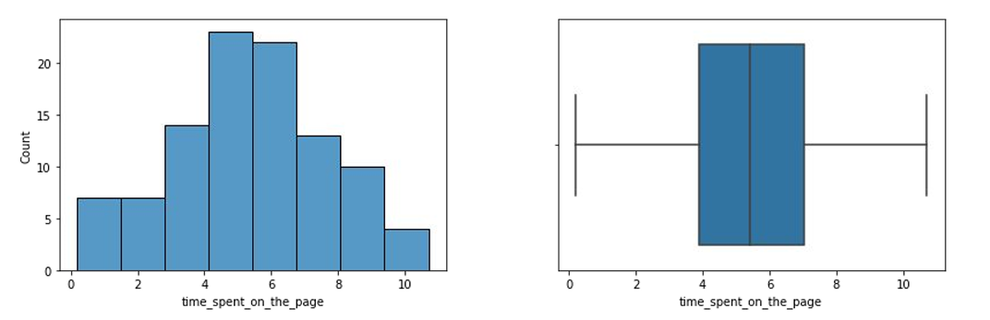
EDA Results – Time spent on the page
The time spent on the page seems to have an almost normal distribution.
There are no outliers in this column.

Slide 6
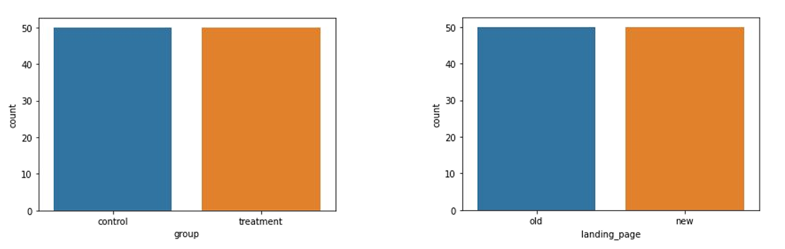
EDA Results – Group & Landing Page
There are 2 unique groups - control and treatment.
The distribution of the number of users across the two groups are the same
There are 2 landing pages - new and old.
The distribution of the number of users across the two landing pages is the same.

Slide 7
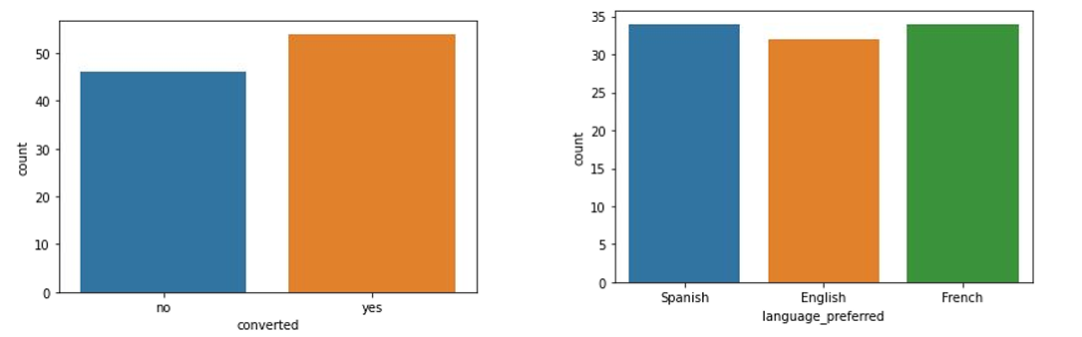
EDA Results – Converted status & Preferred language
Overall, 54 users get converted after visiting the landing page.
46 users do not get converted after visiting the landing page.
The distribution of the number of users across various preferred languages above is almost uniform.
There are 3 unique preferred languages - English, French, and Spanish. Spanish and French both have been equally and mostly preferred by users.

Slide 8
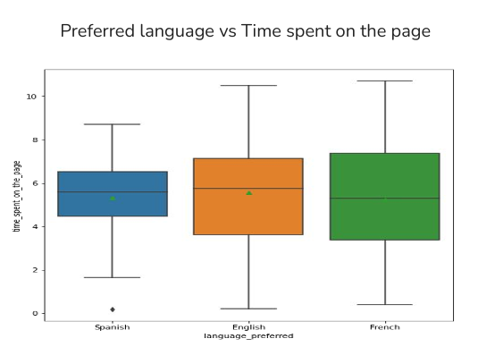
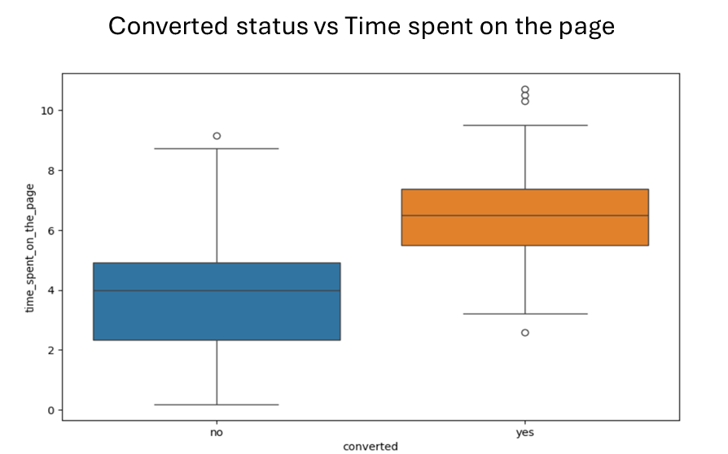
EDA Results - Bivariate Analysis
The median time spent by the different language users are approximately equal.
Overall, the users who get converted tend to spend more time on the page..

Slide 9
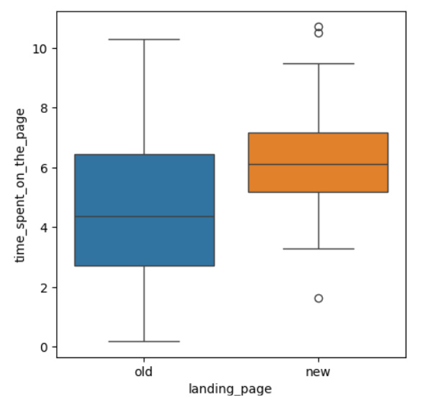
Time spent on the old vs. the new Landing page
From the sample data, it is observed that the median time spent on the new landing page is higher than that on the old landing page.
The hypothesis that users spend more time on the new landing page than on the existing landing page was tested.
The test results showed enough statistical evidence to conclude that the mean time spent by the users on the new page is greater than the mean time spent by the users on the old page.

Slide 10
EDA Results – Converted status & Preferred Language
Overall, 54 users get converted and 46 users do not get converted after visiting the landing page
The distribution of the number of users across various preferred languages is fairly uniform.
There are 3 unique preferred languages - English, French, and Spanish. Spanish and French both have been equally and mostly preferred by users

Slide 11
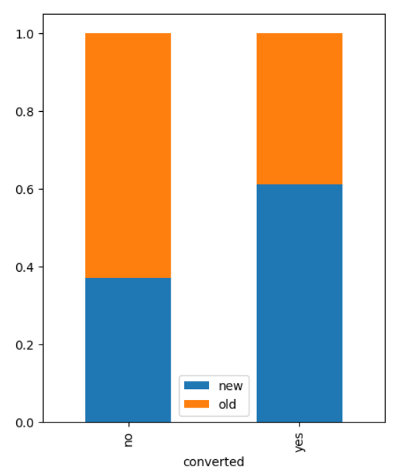
Conversion Rate on old vs new landing page
From the sample data, it is observed that the number of users who get converted to subscribers (conversion rate) is higher for the new page than the old page.
The hypothesis that the conversion rate for the new page is greater than the old page was tested.
The test results showed enough statistical evidence to conclude that the conversion rate for the new page is greater than the conversion rate for the old page.

Slide 12
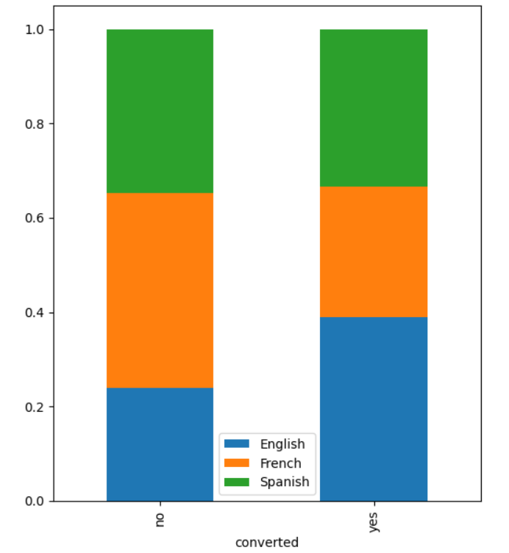
Dependence of conversion on preferred language
From the sample data, it is observed that among the converted users, the count of English users is highest, and among the non-converted users, the count of French users is the highest.
The hypothesis that the converted status is dependent on the preferred language was tested.
The test results showed that there isn’t enough statistical evidence to say that the converted status depends on the preferred language.

Slide 13
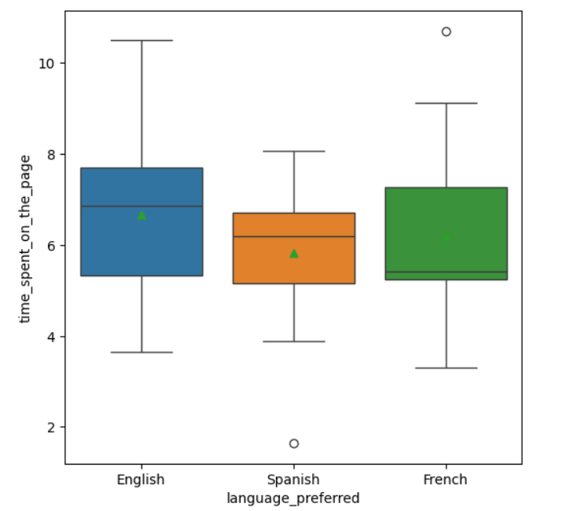
Time spent on the new page for the different language users
From the sample data, it was observed that the median time spent on the new page by English users is a bit higher than that by French and Spanish users.
The hypothesis that at least one of the mean times spent on the new page by English, French, and Spanish users is unequal
The test results showed that there isn’t enough statistical evidence to say that at least one of the mean times spent on the new page by English, French, and Spanish users is unequal.

Slide 14




Appendix

Slide 15
Data Background and Contents
The dataset contains 100 observations and 6 attributes
5 of the attributes (including user_id) are categorical in nature, while one is numerical
There are no missing values in the dataset
The statistical summary of the data shows us the following
The time spent by users on the landing page ranges from 11 seconds to 11 minutes, with an average of 5.4 minutes
Variables ‘group’, ‘landing_page’, and ‘converted’ have only two categories
More than 50% of users are converted
There are three categories of languages preferred by users, among which Spanish has been preferred the most by users.

Slide 16
Hypothesis Testing Details
The null hypothesis
H₀: μ₁ = μ₂
was tested against the alternative hypothesis
H_{a}: μ₁ > μ₂
where μ₁ and μ₂ denote the mean time spent by the users on the new and the old landing pages, respectively.
Since we need to test for the equality of means with unequal and unknown standard deviations from two independent populations, a two-sample independent t-test was performed.
A p-value of 0.0001 was obtained, which is lower than the significance level of 0.05, so the null hypothesis was rejected.

Slide 17
Hypothesis Testing Details
The null hypothesis
H0: p₁ = p₂
was tested against the alternative hypothesis
Ha: p₁ > p₂
where p₁ and p₂ denote the conversion rate for the new and old page, respectively.
Since we need to test for the equality of proportions from two independent populations, a two-sample proportion z-test was performed
A p-value of 0.0080 was obtained, which is lower than the significance level of 0.05. So, the null hypothesis was rejected

Slide 18
Hypothesis Testing Details
The null hypothesis H₀ (the converted status is independent of the preferred language).
was tested against
The alternative hypothesis H_{a} (the converted status that is not independent of the preferred language).
Since we need to test the independence between two categorical variables, a chi-square test for independence was performed
A p-value of 0.2130 was obtained, which is higher than the significance level of 0.05. So, we fail to reject the null hypothesis

Slide 19
Hypothesis Testing Details
The null hypothesis H₀ (The mean time spent on the new page by English, French, and Spanish users are equal).
The alternative hypothesis, H_{a} (At least one of the mean times spent on the new page by English, French, and Spanish users is unequal).
Since we need to test the equality of means from three independent populations, a one-way ANOVA test was performed
A p-value of 0.4320 was obtained, which is higher than the significance level of 0.05. So, we fail to reject the null hypothesis

